Slide 1



Gradient-based Inference for Networks with Output Constraints
Jay Yoon Lee† Sanket Vaibhav Mehta† Michael Wick‡ Jean-Baptiste Tristan‡ Jaime Carbonell†
†
‡
Notes:
Thanks for coming to …
Especially thank committee members taking their time

Slide 2
Output constraints?
Gradient-based Inference for Networks with Output Constraints
Notes:
I talk mainly about hard constraints.
Which can be interchanged with "rules"

Slide 3
Constraints?
Grammar (example 1)
I are presenting on my thesis proposal.
I am presenting on my thesis proposal.
The keys is on the table.
The keys are on the table.
The keys to the cabinet is on the table.
The keys to the cabinet are on the table.
Linzen et al, Assessing the Ability of LSTMs to Learn Syntax-Sensitive Dependencies, 2016
Notes:
Can be defined just over the sentence itself
Rules for consistency and logical agreement.

Slide 4
Constraints?
Grammar (example 1)
I are presenting on my thesis proposal.
I am presenting on my thesis proposal.
The keys is on the table.
The keys are on the table.
The keys to the cabinet is on the table.
The keys to the cabinet are on the table.
Constraint violating
If subject, verb do not agree.
(singular/plural)
Linzen et al, Assessing the Ability of LSTMs to Learn Syntax-Sensitive Dependencies, TACL 2016
Notes:
subject is ’singular or plural’
By contrast, the language model trained without explicit grammati- cal supervision performed worse than chance on the harder agreement prediction cases

Slide 5
Constraints?
Image-captioning (example 2)
Input
(image)
Output
(caption)
A woman is talking on a cell phone.
Rohrbach et al, Object Hallucination in Image Captioning, EMNLP 2018
Notes:
generating relevant caption to the provided input.
As you can see,

Slide 6
Constraints?
Image-captioning (example 2)
Input
(image)
Constraint violating
If an entity/object not present in the picture appears on the caption.
Output
(caption)
A woman is talking on a cell phone.
A woman is talking on a cell phone while sitting on a bench.
A woman is talking to a mouth.
A woman is talking to a pizza.
Rohrbach et al, Object Hallucination in Image Captioning, EMNLP 2018
Notes:
Constraints can be defined in relation to ’input’ and ‘output’

Slide 7
Constraints?
Image-captioning (example 2)
Input
(image)
Constraint violating
If an entity/object not present in the picture appears on the caption.
Output
(caption)
A woman is talking on a cell phone.
A woman is talking on a cell phone while sitting on a bench.
A woman is talking to a mouth.
Probably wrong, but would be another constraint.
A woman is talking to a pizza.
Rohrbach et al, Object Hallucination in Image Captioning, EMNLP 2018
Notes:
As we have seen here,
The constraints I look into are the simple, intuitive rules that is defined on output or on input, output relation.

Slide 8
Neural Network
Gradient-based Inference for Networks with Output Constraints
Notes:
I talk mainly about hard constraints.
Which can be interchanged with "rules"

Slide 9

Typical neural model training
A black box is trained with cross-entropy loss
Maximizing log-likelihood of (input, true output) pair.
Often requires massive amount of data.
$θ$ (model)
X (Input )
Y (output)
Notes:
black box,
because not much of particular modification to the model,
besides input, output representation changes happen in typical neural network training.

Slide 10
Typical neural model training
Black box trained with cross-entropy loss
Maximizing log-likelihood of (input, true output) pair.
Often requires massive dataset. (not very good on small data)
Can we leverage the known constraints?
$θ$ (model)
X (Input )
Y (output)
Notes:
Not just relying on massive data and hoping that your model would learn what you wish model to learn,
Can we force our neural network to learn what we want to learn?

Slide 11
Challenges in injecting constraints
Training set
constraint-satisfying instances (input ,true output)
Thus, constraint is “not explicit” on training set.
Hard to write ‘if-else’ inside black box.
$θ$ (model)
X (Input )
Y (output)
Notes:
Think of the subject-verb agreement example, we would have to first classify all the verb forms & noun forms
On the rule-based model,
this would be very easy.
But, how can we inject constarints into neural network?

Slide 12
Goal of constraint injection
Injection of constraint to
Provide more logical output(constraint-satisfying),
Improve the *model performance,
Especially on out-of-domain data.
Rules/ Constraint
$θ$ (model)
X (Input )
Y (output)
Notes:
During inference time: finding best output given the model
During train time: injecting rules/constraint into the model.

Slide 13
Roadmap
Focus of our work
Applications & constraints
Gradient-Based Inference formulation
Experiments
Conclusion

Slide 14
Considered Application
Transduction (toy)
A transducer (T) is a function from a ‘source language’ (L_{s} ) to a ‘target language’ (L_{T} ).

Slide 15
Transduction constraints
Transduction (toy)
A transducer (T) is a function from a ‘source language’ (L_{s} ) to a ‘target language’ (L_{T} ).
Multiple (input, output) pairs
[Source] azazbz
[Target] aaaaaazb
[Source] azbzazbzbzaazbzbzbzbzbz
[Target] aaazbaaazbzbaaaaaazbzbzbzbzb
…
Notes:
Source & target both only are comprised of {‘a’, ‘b’, ‘z’}

Slide 16
Transduction constraints
Transduction (toy)
A transducer (T) is a function from a ‘source language’ (L_{s} ) to a ‘target language’ (L_{T} ).
e.g. )
T: az → aaa
bz → zb
S: azazbzazbzbzazbzbzbzbzbz
T: aaaaaazbaaazbzbaaazbzbzbzbzb
constraint:
3 x (# a in S) = # a in T
Notes:
We will examine even this simplest constraint would work using the proposed methods.
---------------
The training set comprises 1934 sequences of length 2–20 and the test set contain sentences of lengths 21-24.
network fails to learn this constraint because doing so would require counting and memo- rizing the number of input a0s over long sequences of characters.

Slide 17
Considered Applications in NLP
Syntactic Parsing
Finding structure of the provided (input) sentence.
S
Tree
NP
VP
.
Parser
John
NP
has
Equivalent
information
a
dog
X (Input )
Y (output)
John has a dog .
(S (NP xx) (VP xx (NP xx xx))
Linearized Tree

Slide 18
Considered Applications in NLP
Syntactic Parsing
Finding structure of the provided (input) sentence.
S
Tree
NP
VP
.
Parser
John
NP
has
Equivalent
information
a
dog
X (Input )
Y (output)
John has a dog .
(S (NP xx) (VP xx (NP xx xx))
Linearized Tree
To use Sequence-to-Sequence model:
models relationship between sequence input & sequence output.

Slide 19
Constraints in Parsing
Syntactic Parsing
Finding structure of the provided (input) sentence.
Parser
John has a dog
True:
(S (NP xx) (VP xx(NP xx xx))
Others:
(S (NP xx) (VP xx (NP xx xx))) ))
( (S (NP xx) (VP xx (NP xx xx))
(S (NP xx) ) )(VP xx (NP xx xx)))
(S (NP xx xx xx xx xx))
(S (NP xx) (VP xx xx xx))
Now you use seq2seq model,
The model might generate constraint-violating outputs
Notes:
opening # of brackets,
closing # of brackets don't match

Slide 20
Constraints in Parsing
Syntactic Parsing
Finding structure of the provided (input) sentence.
Parser
John has a dog
True:
(S (NP xx) (VP xx(NP xx xx))
Constraint:
“# open - # closing bracket = 0”
“# of input tokens has to match # of children on the tree”
Others:
(S (NP xx) (VP xx (NP xx xx))) ))
( (S (NP xx) (VP xx (NP xx xx))
(S (NP xx) ) )(VP xx (NP xx xx)))
(S (NP xx xx xx xx xx))
(S (NP xx) (VP xx xx xx))
Notes:
and also # of input tokens,
has to match # of children on the tree.

Slide 21
Constraints in Parsing
Syntactic Parsing
Finding structure of the provided (input) sentence.
Parser
John has a dog
True:
(S (NP xx) (VP xx(NP xx xx))
Output space intrinsic
Constraint:
“# open - # closing bracket = 0”
“# of input tokens has to match # of children on the tree”
Others:
(S (NP xx) (VP xx (NP xx xx))) ))
( (S (NP xx) (VP xx (NP xx xx))
(S (NP xx) ) )(VP xx (NP xx xx)))
(S (NP xx xx xx xx xx))
(S (NP xx) (VP xx xx xx))
(Input, output)
relation
Notes:
and also # of input tokens,
has to match # of children on the tree.

Slide 22
Considered Applications in NLP
Semantic Role Labeling (SRL)
Finding ( Agent (arg0), Patient (arg1) ) given verb
SRL
X (Input )
Y (output)
John broke the window with a hammer.
verb: broke
ARG0: John
ARG1: the window
ARG2: a hammer
Notes:
john agent
window patinet
and tool is a hammer.

Slide 23


Semantic Role Labeling
Application 1: Semantic Role Labeling (SRL)
Finding ( Agent (arg0), Patient (arg1) ) given verb
subj
V
obj
John broke the window with a hammer.
agent
(actor of an action)
patient
(entity affected by the action)
instrument
(tool used in performing action)
Notes:
A bit of explanation on imitation learning

Slide 24
Semantic Role Labeling
Application 1: Semantic Role Labeling
Finding ( Agent (arg0), Patient (arg1) ) given verb
Core Roles: Verb specific roles (ARG0, ARG1, …, ARG5)
Adjunct roles: Shared across all verbs
subj
V
obj
Verb: break
John broke the window with a hammer.
Role | Description
ARG0 | breaker (agent)
ARG1 | thing broken (patient)
ARG2 | instrument used
... | ...
Role | Description
ARGM-TMP | temporal
ARGM-DIR | direction
ARGM-LOC | location
... | ...
agent
(actor of an action)
patient
(entity affected by the action)
instrument
(tool used in performing action)
Notes:
A bit of explanation on imitation learning

Slide 25
Application using SRL
Question answering (5W1H)
“Who” questions usually use Agents. (Arg0)
“What” questions usually use Patients. (Arg1)
“How” and “with what” questions usually use Instruments. (Arg2)
“Where” questions frequently use Sources and Destinations . (ARGM-LOC)
“For whom” questions usually use Benefactives. (Arg1)
“To whom” questions usually use Destinations.
Notes:
As many of the answers to question corresponds to SRL arguments,
We can simply run SRL to answer questions OR use it to prune the answer candidatess

Slide 26

Semantic Role Labeling
Application 1: Semantic Role Labeling
Finding ( Agent (arg0), Patient (arg1) ) given verb
SRL
X (Input )
Y (output)
John broke the window with a hammer.
verb: broke
ARG0: John
ARG1: the window
ARG2: a hammer
Notes:
And again, because we are doing neural network,
we have this black box for SRL

Slide 27
Complex task
Complex task (sometimes) is sometimes easier to model when the task is divided into multiple ones
model1
model2
Z
X (Input )
Y (output)

Slide 28
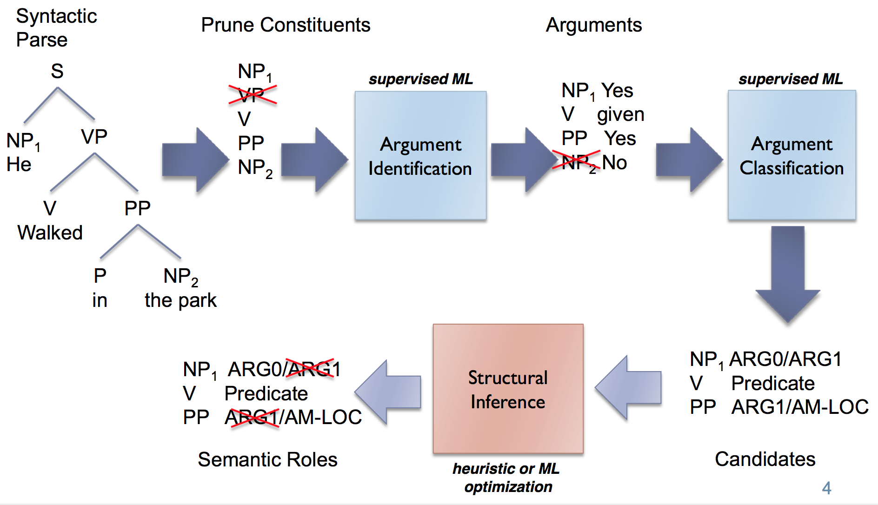
Complex models - example
Semantic Role Labeling (step by step)
X (Input )
“He walked in the park”
Y (output)
VERB – walked
ARG0 – He
LOC– in the park
Notes:
Use combinatorial search (or proper optimization) to find correct Roles for candidate spans.
You can view SRL as an multi-task problem
of chunking to get proper spans,
and classification problem for argument lables.

Slide 29
Complex models - example
Model 1
Model 2
Semantic Role Labeling
X (Input )
“He walked in the park”
Y (output)
VERB – walked
ARG0 – He
LOC– in the park
Model3
Notes:
Model1: Proper candidates

Slide 30
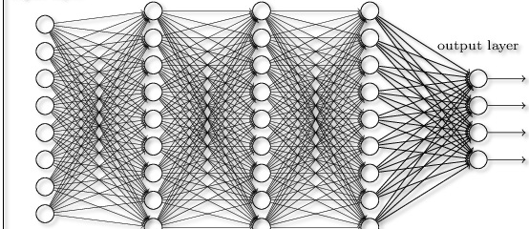
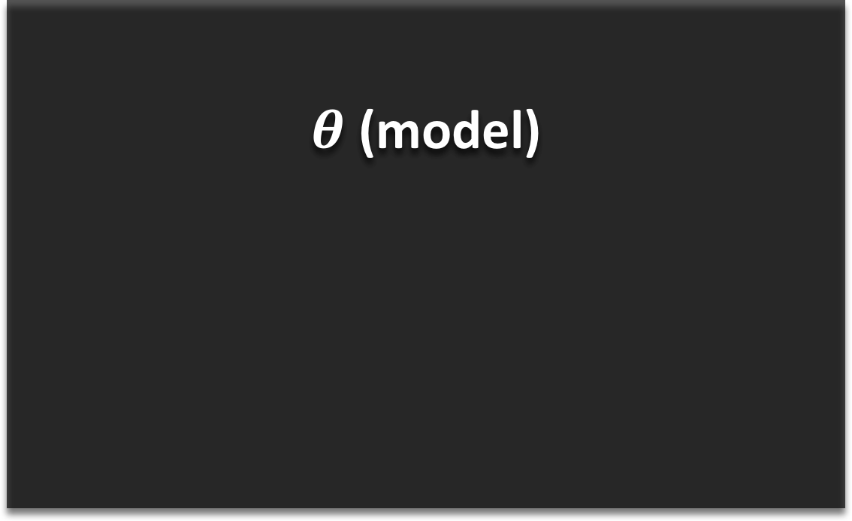
Complex models to End-to-End
End-to-end Semantic Role Labeling.
Neural models often perform better on end-to-end learning.
$θ$ (model)
X (Input )
“He walked in the park”
Y (output)
VERB – walked
ARG0 – He
LOC– in the park

Slide 31
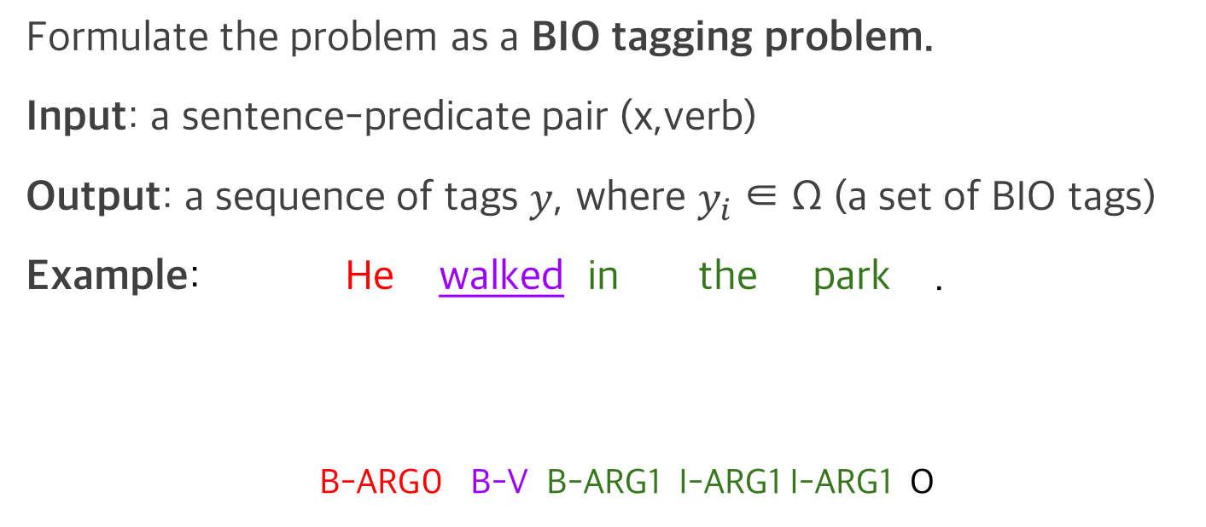
How to solve it?
Formulate the problem as a BIO tagging problem.
Input: a sentence-predicate pair (x,verb)
Output: a sequence of tags $y$, where $y_{i}$ ∈ Ω (a set of BIO tags)
Example: He walked in the park .
B-ARG0 B-V B-ARG1 I-ARG1 I-ARG1 O
SRL System
Slide credits: Sanket Metha
Notes:
A bit of explanation on imitation learning

Slide 32
What are different constraints for SRL task?
BIO constraints
Constraint violation: B-ARG0 followed by I-ARG1
(similar to the constraints in Parsing example)
SRL constraints (as defined by Punyakanok et al. (2008))
Unique core roles (U)
Continuation roles (C)
Reference roles (R)
Syntactic constraints
Constraint violation: Arguments that are not constituents within a given parse tree

Slide 33
Syntactic constraint on SRL
Given syntax tree, span candidates were limited by syntactic information.
X (Input )
Possible span candidate
“He walked in the park”
(He), (walked), (in the park),
(walked in the park), (He walked in the park)
(He) (walked) (in the park)

Slide 34
Syntactic constraint on SRL
Given syntax tree, span candidates were limited by syntactic information.
X (Input )
Possible span candidate
“He walked in the park”
(He), (walked), (in the park),
(walked in the park), (He walked in the park)
(He) (walked) (in the park)
(He) (walked in)(the park)
(He walked) (in the park)
(He walked in the)(park)
(He walked in the park)
However, end-to-end model without syntactic information can generate
all possible “spans” given sentence.

Slide 35
Syntactic constraint on SRL
Given syntax tree, span candidates were limited by syntactic information.
X (Input )
Possible span candidate
“He walked in the park”
(He), (walked), (in the park),
(walked in the park), (He walked in the park)
(He) (walked) (in the park)
(He) (walked in)(the park)
(He walked) (in the park)
(He walked in the)(park)
(He walked in the park)
However, end-to-end model without syntactic information can generate
all possible “spans” given sentence.

Slide 36
Syntactic constraint on SRL
Given syntax tree, span candidates were limited by syntactic information.
X (Input )
Possible span candidate
“He walked in the park”
(He), (walked), (in the park),
(walked in the park), (He walked in the park)
(He) (walked) (in the park)
(He) (walked in)(the park)
(He walked) (in the park)
(He walked in the)(park)
(He walked in the park)
However, end-to-end model without syntactic information can generate
all possible “spans” given sentence.
Constraint-violating
Notes:
Cutting in-between the sub-tress,
Rather than enclosing it.

Slide 37
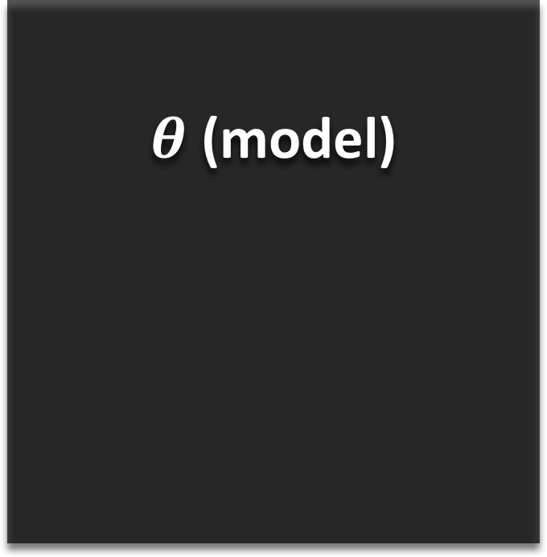
Inference using constraint
Inference: Finding the best output given the model.
$θ$ (model)
X (Input )
“He walked in the park”
Post Processing
Constraint
Y (output)
VERB – walked
ARG0 – He
LOC– in the park
Notes:
With these applications & constraints,
I am going to explore
Inference
Learning With constraints

Slide 38
Inference using constraint
Proper “Injection of constraints” to the model on Inference step.
$θ$ (model)
X (Input )
“He walked in the park”
Constraint
Y (output)
VERB – walked
ARG0 – He
LOC– in the park
Notes:
(more than simply filtering out violating output)

Slide 39
Roadmap
Focus of our work
Applications & constraints
Gradient-Based Inference formulation
Experiments
Conclusion

Slide 40
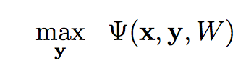
Gradient-Based Inference* (GBI)
Inference
Finding the output with the highest model probability.
Learned model
Notes:
Next: To express this constraint satisfaction esaily,

Slide 41
Gradient-Based Inference* (GBI)
Inference
Finding the output with the highest model probability.
Given length m, vocabulary size V, the search space becomes V^m.
Viterbi decoding (exact)
Sequence-to-sequence models have no limit to length m, thus the search space is larger.
Greedy decoding, beam decoding
Notes:
Discrete sequence search problem
Approximate
Next: To express this constraint satisfaction esaily,

Slide 42
Constraint function
Constraint (evaluation) function. (Error counting)
no constraint violation
Notes:
Define a positive constraint function $g$.
0 if and only if
there is no constraint violation

Slide 43
Constraint function
Constraint evaluation function. (degree of error, higher the more error)
no constraint violation
Optimization with constraints
Constraint
for feasible set L^{x}
Notes:
Rewriting the optimization function

Slide 44
Gradient-Based Inference* (GBI)
Inference with constraint
Finding the output with the highest model probability given (local, global )constraint.
Given length m, vocabulary size V, the search space becomes V^m.
Viterbi decoding (exact), A* algorithm (DP)
Sequence-to-sequence models have no limit to length m, thus the search space is larger.
Greedy decoding, beam decoding
constraint
Notes:
Next: To express this constraint satisfaction esaily,

Slide 45
Gradient-Based Inference* (GBI)
Inference with constraint
Finding the output with the highest model probability given (local, global )constraint.
Given length m, vocabulary size V, the search space becomes V^m.
Viterbi decoding (exact), A* algorithm (inexact DP)
Sequence-to-sequence models have no limit to length m, thus the search space is larger.
Greedy decoding, beam decoding
Notes:
Inexact Dynamic Programing

Slide 46
Gradient-Based Inference* (GBI)
Inference with constraint
Finding the output with the highest model probability given (local, global )constraint.
Given length m, vocabulary size V, the search space becomes V^m.
Viterbi decoding (exact), A* algorithm (inexact DP)
Sequence-to-sequence models have no limit to length m, thus the search space is larger.
Approximate by greedy decoding, beam decoding
Very slow on exponential search space
Fast but localized approach thus cant incoporate ‘global’ constraint. (not localizeable)
Notes:
Not localizeable like the parsing example.
or not global, but fairly long sequence dependency.

Slide 47
Gradient-Based Inference (GBI)
Optimization with constraints
Notes:
Throw in some neural network equations h_t = f(W*x_t)

Slide 48
Gradient-Based Inference (GBI)
Optimization with constraints
Gradient-Based Inference (in math)
Combinatorial problem.
Can we search faster
by changing model weights?
Notes:
by tweaking the model weights
as we want.

Slide 49
Gradient-Based Inference (GBI)
Motivation
Optimization with constraints
Gradient-Based Inference
Likelihood
Constraint violation
Notes:
minimizing probabilities of example
that are constraint violating,
but may go to trivial solution
or
may forget what it learned before,

Slide 50
Gradient-Based Inference (GBI)
Motivation
Optimization with constraints
Gradient-Based Inference
Learned model weight
Expected
constraint violation
Regularizer
Notes:
This is instance-based optimization,
so we reset and make W_l to be W again
for new example.

Slide 51
Gradient-Based Inference (GBI)
Motivation
Optimization with constraints
Gradient-Based Inference (in math)
Standard Lagrangian
Very slow. (combinatorial) Especially global constraint
Greedy, beam-search relatively fast
Notes:
Throw in some neural network equations h_t = f(W*x_t)

Slide 52
Gradient-Based Inference (GBI)
Motivation
Optimization with constraints
Gradient-Based Inference (in math)
Standard Lagrangian
Combinatorial problem.
Very slow. (combinatorial) Especially global constraint
Now, with expected constraint violation,
we can “reflect” global constraints.
Using the two, can we search faster
by changing model weights?
Greedy, beam-search relatively fast
Notes:
as opposed traversing simply on
the output space as usual?

Slide 53
Roadmap
Focus of our work
Applications & constraints
Gradient-Based Inference formulation
Research questions & Experiments
Conclusion

Slide 54
Research Questions
Q1. Does GBI actually enforce constraints?
Q2. Does GBI enforce constraints without compromising the quality of the system?
Q3. Can GBI work over multiple baseline model?
Q4. Performance of GBI on out-of-domain dataset?
Notes:
Throw in some neural network equations h_t = f(W*x_t)

Slide 55
Research Questions
Q1. Does GBI actually enforce constraints?
Q2. Does GBI enforce constraints without compromising the F1 score of the system?
Q3. Can GBI generalize over multiple baseline model?
Q4. Performance of GBI on out-of-domain dataset?
Notes:
Throw in some neural network equations h_t = f(W*x_t)

Slide 56
Research Questions
Q1. Does GBI actually enforce constraints?
Q2. Does GBI enforce constraints without compromising the F1 score of the system?
Q3. Can GBI generalize over multiple baseline model?
Q4. Performance of GBI on out-of-domain dataset?
Notes:
Throw in some neural network equations h_t = f(W*x_t)

Slide 57
Research Questions
Q1. Does GBI actually enforce constraints?
Q2. Does GBI enforce constraints without compromising the F1 score of the system?
Q3. Can GBI generalize over multiple baseline model?
Q4. Performance of GBI on out-of-domain dataset?
Notes:
Throw in some neural network equations h_t = f(W*x_t)

Slide 58
Research Questions
Q1. Does GBI actually enforce constraints?
Q2. Does GBI enforce constraints without compromising the F1 score of the system?
Q3. Can GBI generalize over multiple baseline model?
Q4. How is the performance of GBI on out-of-domain dataset?
Notes:
Throw in some neural network equations h_t = f(W*x_t)

Slide 59
Back to SRL
Revisiting Semantic Role Labeling (SRL)
Finding ( Agent (arg0), Patient (arg1) ) given verb
SRL
X (Input )
Y (output)
“He walked in the park”
VERB – walked
ARG0 – He
LOC– in the park
Notes:
Throw in some neural network equations h_t = f(W*x_t)

Slide 60
Syntactic constraint on SRL
Given syntax tree, span candidates were limited by syntactic information.
X (Input )
Possible span candidate
“He walked in the park”
(He), (walked), (in the park),
(walked in the park), (He walked in the park)
(He) (walked) (in the park)
(He) (walked in)(the park)
(He walked) (in the park)
(He walked in the)(park)
(He walked in the park)
Wrong spans marked with strike
Notes:
As we discussed, let’s define the constraint function

Slide 61
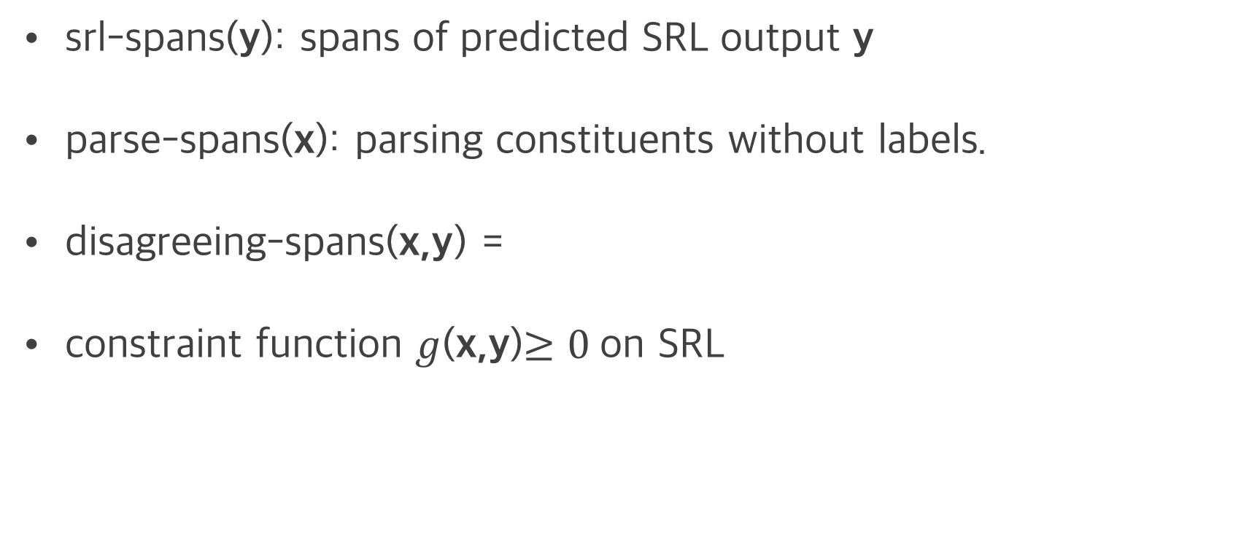
Constraint on SRL
srl-spans(y): spans of predicted SRL output y
parse-spans(x): parsing constituents without labels.
disagreeing-spans(x,y) =
constraint function $g$(x,y)$≥0$on SRL

Slide 62
Constraint on SRL
Constraint (violation) scores on previous exmaple
Possible span candidate
(He), (walked), (in the park),
(walked in the park), (He walked in the park)
X (Input )
“He walked in the park”
g(x,y)
0.0
0.33
0.5
1.0
0.0
(He) (walked) (in the park)
(He) (walked in)(the park)
(He walked) (in the park)
(He walked in the)(park)
(He walked in the park)
Assign scores to the constraint- violating output
Y (output)
VERB – walked
ARG0 – He
LOC– in the park

Slide 63
GBI on SRL: Experiments
OntoNotes v5.0, CoNLL-2012 shared task (278k train, 38.3k dev, 25.6k test)
Gold predicates and gold parse constituents are given (~10% noisy annotations) .
Baseline architecture
multi-layer highway bi-directional LSTM (ELMo embedding)
Notes:
With the defined constraints,
And with the proposed GBI

Slide 64
GBI on SRL: Experiments
Statistics
Failure set: Set of instances where SRL output violates simple constraint.
Failure rate (%): Relative size of failure set compared to whole test set.
Conv rate (%): The relative portion of the failure set converted to constraint-satisfying output after GBI.
Notes:
GBI only affects the ones that has failures.

Slide 65
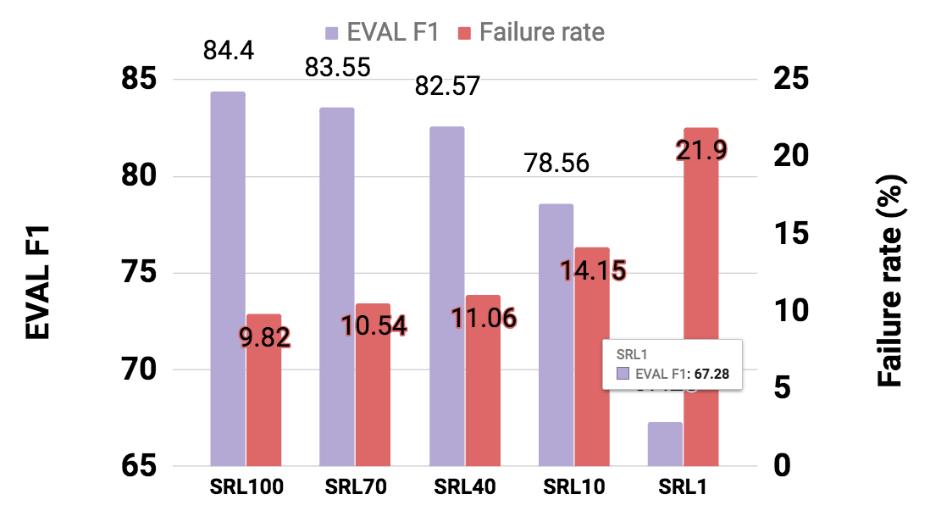
GBI on SRL: Experiments
Trained 5 networks with different level of performance by using different amounts of data (1%,10%, …,100%)
SRL x : SRL system trained on x % data.

Slide 66
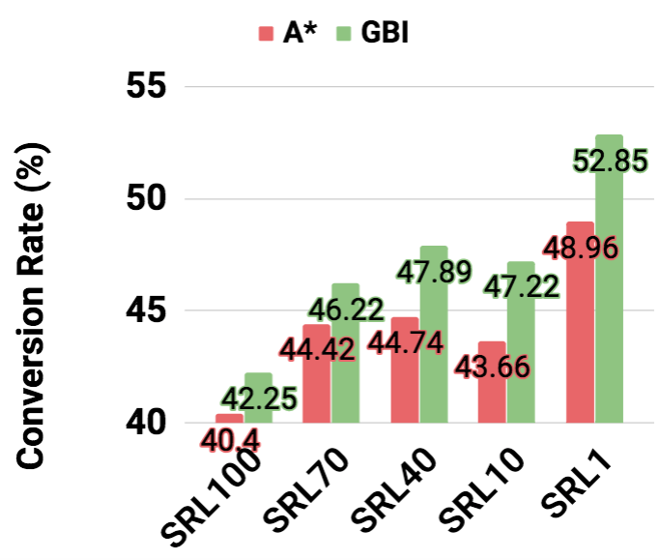
GBI on SRL: Experiments
Q3: GBI enforces constraints. (much better than A*)

Slide 67
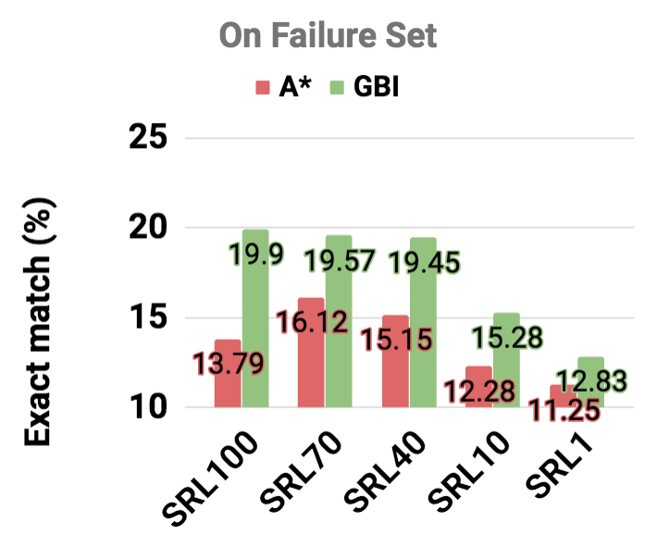
GBI on SRL: Experiments
Q3: GBI enforces constraints without hurting the system.
On Failure Set
SRL x : SRL system trained on x % data.

Slide 68
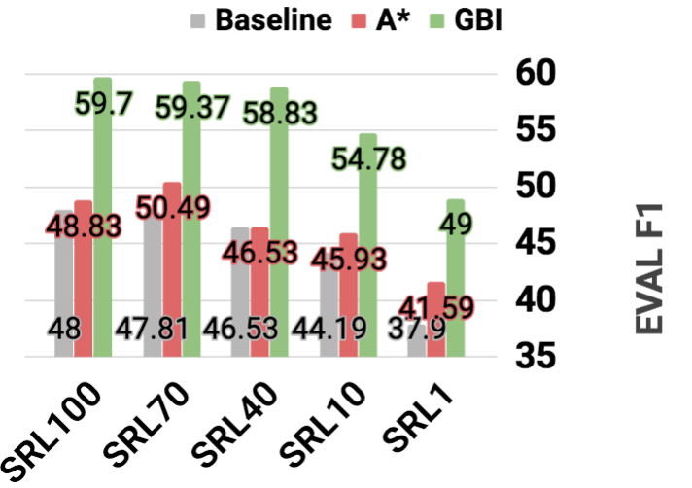
GBI on SRL: Experiments
Q3: GBI enforces constraints without hurting the system.
In fact, it improves the overall system performance
On Failure Set
SRL x : SRL system trained on x % data.

Slide 69
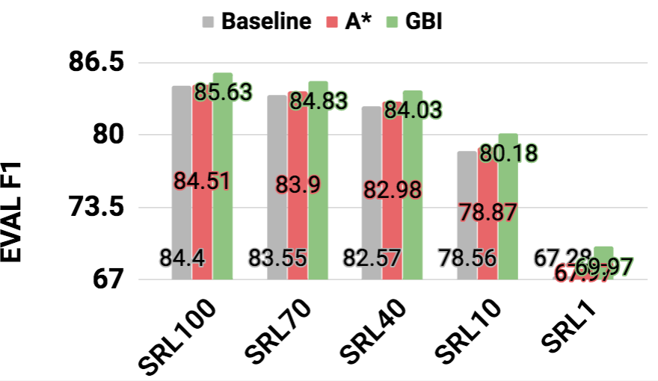
GBI on SRL: Experiments
Q3: GBI enforces constraints without hurting the system.
In fact, it improves the overall system performance
On Total test set
SRL x : SRL system trained on x % data.

Slide 70
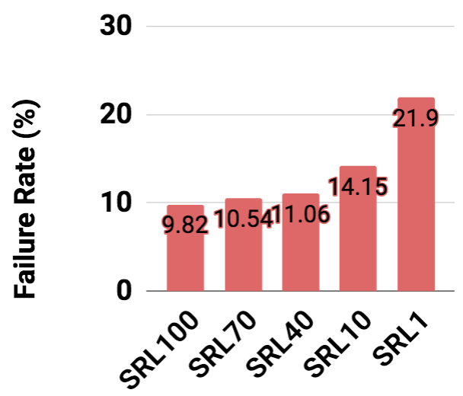
GBI on SRL: Experiments
Q4: Not sensitive to the baseline model performance
On Failure Set
Notes:
Q5 will be dealt later.

Slide 71
Application 2: Syntactic Parsing
By a linguist
Deterministic rule based. (thousands of rules)
Statistical methods
O(N³) and accurate
O(N) and inaccurate
State of the art: Neural Networks.
Using generic sequence-to-sequence model
Using span-based models
Notes:
A bit of explanation on imitation learning

Slide 72
Constraints on parsing model
seq2seq does not guarantee “very simple rule”.
Parser
John has a dog
True:
(S (NP xx) (VP xx(NP xx xx))
Rules:
“# open - # closing bracket = 0”
“# of input tokens has to match # of children on the tree”
Others:
(S (NP xx) (VP xx (NP xx xx))) ))
( (S (NP xx) (VP xx (NP xx xx))
(S (NP xx) ) )(VP xx (NP xx xx)))
(S (NP xx xx xx xx xx))
(S (NP xx) (VP xx xx xx))
Notes:
A bit of explanation on imitation learning

Slide 73
Constraints function
Rules
# of input tokens = # of children on output tree
# opening brackets = # of closing brackets
Constraint function definition (x:input, y: output)
Simple count of errors normalized by sum of input, output length.
Roughly speaking:
Notes:
(S (NP xx) (VP xx(NP xx xx))

Slide 74
GBI on parsing: Experiments
Trained 5 parsers to answer Q1-4 (especially Q3)
Net1-2: GNMT (bi-directional encoder, uni-directional decoder)
Net3-5: uni-directional encoder, decoder.
Different dropout, used different portion of the dataset.
GNMT: Wu et al, Google's Neural Machine Translation System: Bridging the Gap between Human and Machine Translation, 2016
Notes:
A bit of explanation on imitation learning

Slide 75
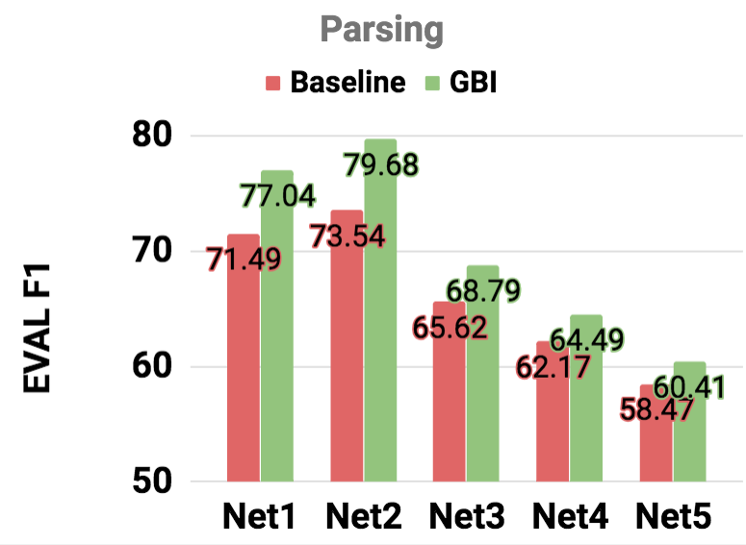
GBI on parsing: Experiments
Similar trend.
Again, GBI
Improves all cases.
Notes:
A bit of explanation on imitation learning

Slide 76
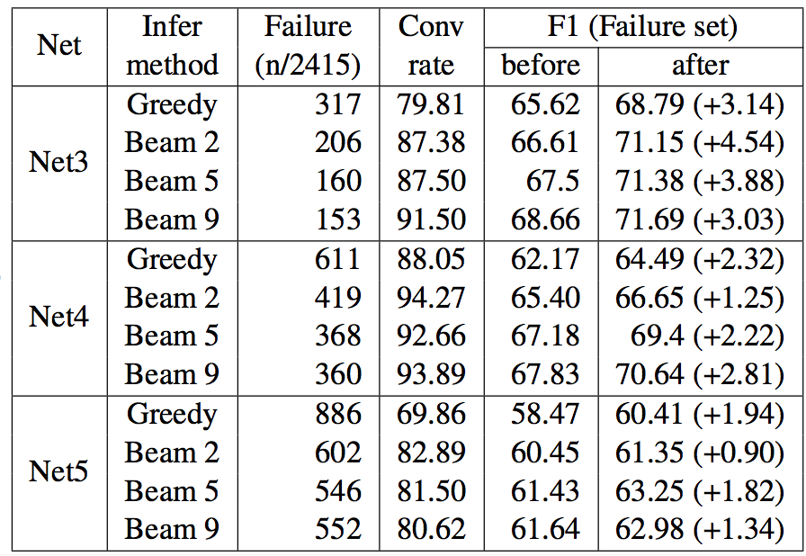
GBI on parsing: Experiments
Q4: Not sensitive to the baseline model performance.
Not only that, GBI is also compatible with various decoding methods.
Notes:
A bit of explanation on imitation learning

Slide 77
GBI on parsing: Experiments
Q4: Not sensitive to the baseline model performance.
Not only that, GBI is also compatible with various decoding methods.
More details,
Please refer to the paper.
Notes:
A bit of explanation on imitation learning

Slide 78
GBI on transducer
Transduction (toy)
A transducer (T) is a function from a ‘source language’ (L_{s} ) to a ‘target language’ (L_{T} ).
T: az → aaa
bz → zb
Experiment Result
65.2% conversion rate
On Failure set
Before-GBI: 75.2%
After-GBI: 82.4%
S: azazbzazbzbzazbzbzbzbzbz
T: aaaaaazbaaazbzbaaazbzbzbzbzb
constraint:
3 x (# a in S) = # a in T
Notes:
Even this simplistic constraint work.
The training set comprises 1934 sequences of length 2–20 and the test set contain sentences of lengths 21-24.
network fails to learn this constraint because doing so would require counting and memo- rizing the number of input a0s over long sequences of characters.

Slide 79
GBI on transducer
Transduction (toy)
A transducer (T) is a function from a ‘source language’ (L_{s} ) to a ‘target language’ (L_{T} ).
T: az → aaa
bz → zb
Experiment Result
65.2% conversion rate
On Failure set (accuracy)
Before-GBI: 75.2%
After-GBI: 82.4%
S: azazbzazbzbzazbzbzbzbzbz
T: aaaaaazbaaazbzbaaazbzbzbzbzb
constraint:
3 x (# a in S) = # a in T
More details,
Please refer to the paper.
Notes:
Even this simplistic constraint work.
The training set comprises 1934 sequences of length 2–20 and the test set contain sentences of lengths 21-24.
network fails to learn this constraint because doing so would require counting and memo- rizing the number of input a0s over long sequences of characters.

Slide 80
GBI: extra considerations
Robustness to noisy constraint.
Q5) out-of-domain performance.
Notes:
Throw in some neural network equations h_t = f(W*x_t)

Slide 81
Robustness of GBI
SRL has about 10% of the span mismatch between annotated SRL output (propbank) & parse tree (treebank)
Notes:
Throw in some neural network equations h_t = f(W*x_t)

Slide 82
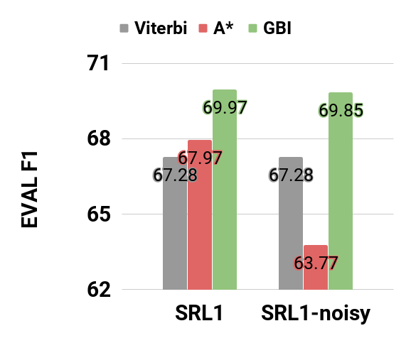
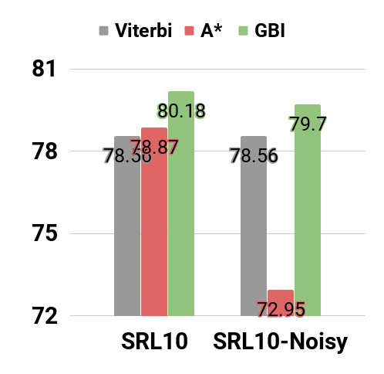
Robustness of GBI
SRL has about 10% of the span mismatch between annotated SRL output (propbank) & parse tree (treebank)
1% - trained
10% - trained
Notes:
Throw in some neural network equations h_t = f(W*x_t)

Slide 83
Robustness of GBI
SRL has about 10% of the span mismatch between annotated SRL output (propbank) & parse tree (treebank)
1% - trained
10% - trained
Noise hurts A* but not much on GBI
Notes:
GBI not only works better than A*
It is far more robust than A*

Slide 84
GBI on out-of-domain data (Q5)
CoNLL2012
NewsWire (NW)
Broadcast Conversation (BC)
Broadcast News (BN)
Pivot Corpus (PT)
Telephone Conversation (TC)
Weblogs (WB)
Notes:
Throw in some neural network equations h_t = f(W*x_t)

Slide 85
GBI on out-of-domain data
CoNLL2012
NewsWire (NW) which includes WSJ
Broadcast Conversation (BC)
Broadcast News (BN)
Pivot Corpus (PT)
Telephone Conversation (TC)
Weblogs (WB)
Source
Domain
Constraint
Target
Domain
Can constraint injection
transfer to other domains?
Notes:
Throw in some neural network equations h_t = f(W*x_t)

Slide 86
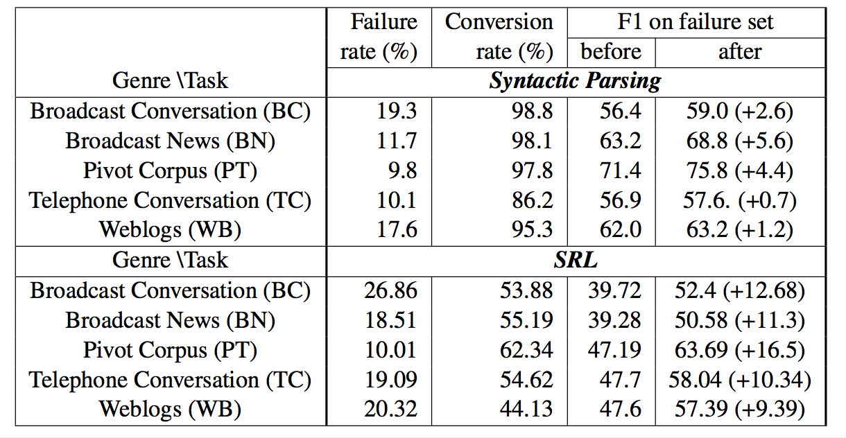
GBI on out-of-domain data
Generally higher failure rate on out-of-domain evaluation compared to in-domain (parsing: 11.9 %, SRL: 18.1%).
Notes:
Throw in some neural network equations h_t = f(W*x_t)

Slide 87
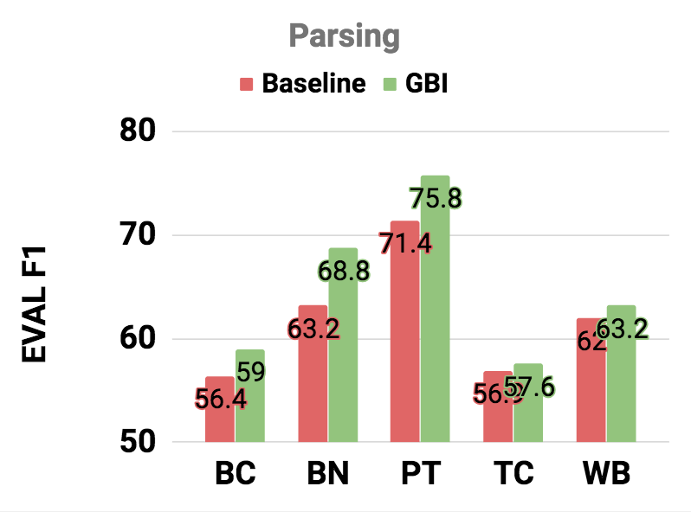
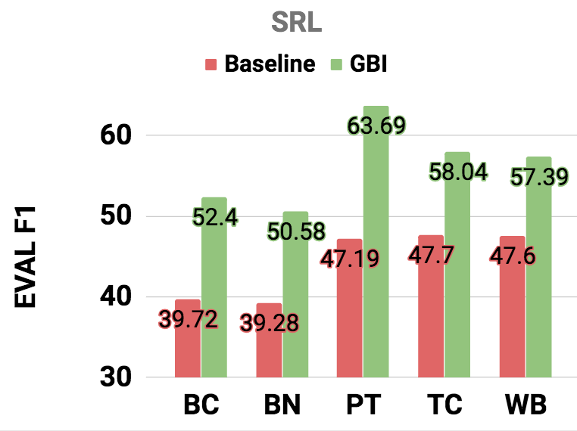
GBI on out-of-domain data
In summary, improves in all cases (reporting on failure set)
While parsing is more sensitive to domains.
Notes:
Throw in some neural network equations h_t = f(W*x_t)

Slide 88
Roadmap
Focus of our work
Applications & constraints
Gradient-Based Inference formulation
Research questions & Experiments
Conclusion

Slide 89

Research Questions
Q1. Does GBI actually enforce constraints?
Yes!
Q2. Does GBI enforce constraints without compromising the quality of the system?
Yes. It rather Improves!
Q3. Is GBI sensitive to the baseline model?
Not on 3 applications (5 experiment settings)
Q4. Performance of GBI on out-of-domain dataset?
Good!
Notes:
Throw in some neural network equations h_t = f(W*x_t)

Slide 90
Thank You!
Questions?
Notes:
저는 deep learning을 통해 자동차의 이상징후들을 미리 예견할 수 있는 머신러닝 모델을 제안하고자 합니다.

Slide 91
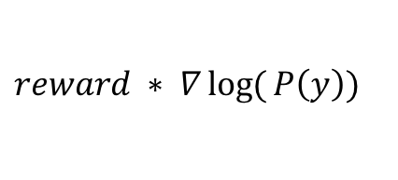

[backup] Learning with constraints
Optimization with constraints
Learning with the reward:
Reward defined by our constraint.
$$reward ∗ ∇\log{(}P\left(y\right))$$
$θ$ (model)
X (Input )
Y (output)
Lee & Mehta et al, Towards semi-supervised learning for deep semantic role labeling, EMNLP2018
Notes:
Throw in some neural network equations h_t = f(W*x_t)

Slide 92
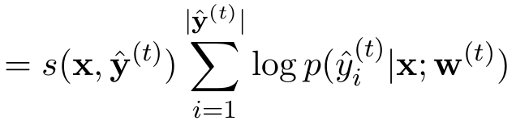
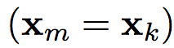
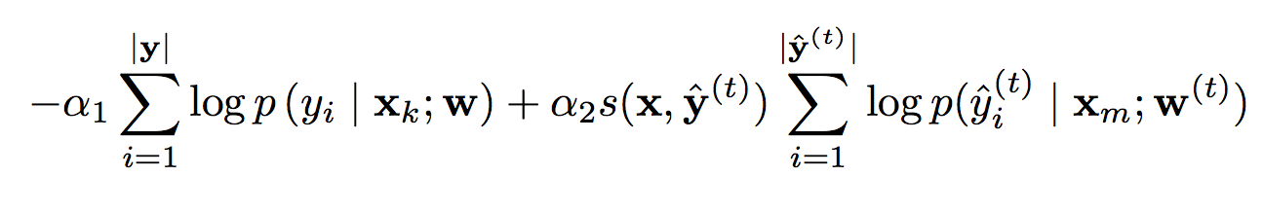
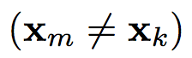
[backup] Learning with constraints
Learning with the reward s(x,y)
constraint loss (c-loss)
Joint loss
Semi-supervised Joint loss
Unlabeled
Constraint
Labeled
Constraint
Unlabeled
Labeled
Constraint
Lee & Mehta et al, Towards semi-supervised learning for deep semantic role labeling, EMNLP2018
SRL-labeled data
SRL-labeled data
SRL-labeled data
SRL-labeled data
SRL-labeled data
SRL-labeled data
SRL-labeled data
SRL-labeled data
SRL-labeled data
SRL-labeled data
SRL-labeled data
SRL-unlabeled data
SRL-unlabeled data
SRL-labeled data
SRL-unlabeled data
SRL-labeled data
SRL-unlabeled data
SRL-labeled data
SRL-unlabeled data
SRL-labeled data
SRL-unlabeled data
SRL-labeled data
SRL-unlabeled data
SRL-labeled data
SRL-unlabeled data
SRL-labeled data
SRL-unlabeled data
Notes:
Throw in some neural network equations h_t = f(W*x_t)

Slide 93

[Revisit] Complex models
Semantic Role Labeling
$θ$ (model)
X (Input )
The cat
loves hats
Y (output)
VERB – love
ARG0 – the cats
ARG1– hats
Slide credits: Luheng He

Slide 94
How to express the Grammar Tree as a sequence?
Proposed model
“As a command” to produce the tree.
Shift-Reduce syntax
Bottom-up approach
Similar to how human minds work.
S
NP
VP
.
John
has
NP
a
dog

Slide 95
How to express the Grammar Tree as a sequence?
Proposed model
“As a command” to produce the tree.
s R-1-NP s s s R-2-NP R-2-VP s R-3-S
Shift-Reduce syntax
s corresponds to “push” in stack.
R-#-XX corresponds to “pop”-ing that # of elements , merging them together to XX, and pushing it back to the stack.
S
NP
VP
.
John
has
NP
a
dog
Notes:
I am going to show an example of shift-reduce syntax
But without all the details, the take away from here is that you can linearize the parse tree
Into corresponding shift-reduce commands.

Slide 96
Shift-Reduce syntax
Proposed model
Original sentence John has a dog .
Shift-Reduce command s R-1-NP s s s R-2-NP R-2-VP s R-3-S

Slide 97
Shift-Reduce syntax
Proposed model
Original sentence John has a dog .
Shift-Reduce command s R-1-NP s s s R-2-NP R-2-VP s R-3-S
John

Slide 98
Shift-Reduce syntax
Proposed model
Original sentence John has a dog .
Shift-Reduce command s R-1-NP s s s R-2-NP R-2-VP s R-3-S
(NP John)

Slide 99
Shift-Reduce syntax
Proposed model
Original sentence John has a dog .
Shift-Reduce command s R-1-NP s s s R-2-NP R-2-VP s R-3-S
has
(NP John)

Slide 100
Shift-Reduce syntax
Proposed model
Original sentence John has a dog .
Shift-Reduce command s R-1-NP s s s R-2-NP R-2-VP s R-3-S
a
has
(NP John)

Slide 101
Shift-Reduce syntax
Proposed model
Original sentence John has a dog .
Shift-Reduce command s R-1-NP s s s R-2-NP R-2-VP s R-3-S
dog
a
has
(NP John)

Slide 102
Shift-Reduce syntax
Proposed model
Original sentence John has a dog .
Shift-Reduce command s R-1-NP s s s R-2-NP R-2-VP s R-3-S
dog
a
has
(NP John)

Slide 103
Shift-Reduce syntax
Proposed model
Original sentence John has a dog .
Shift-Reduce command s R-1-NP s s s R-2-NP R-2-VP s R-3-S
(NP a dog)
has
(NP John)

Slide 104
Shift-Reduce syntax
Proposed model
Original sentence John has a dog .
Shift-Reduce command s R-1-NP s s s R-2-NP R-2-VP s R-3-S.
(VP has (NP a dog) )
(NP John)

Slide 105
Shift-Reduce syntax
Proposed model
Original sentence John has a dog .
Shift-Reduce command s R-1-NP s s s R-2-NP R-2-VP s R-3-S
.
(VP has (NP a dog) )
(NP John)

Slide 106
Shift-Reduce syntax
Proposed model
Original sentence John has a dog .
Shift-Reduce command s R-1-NP s s s R-2-NP R-2-VP s R-3-S
.
(VP has (NP a dog) )
(NP John)

Slide 107
Shift-Reduce syntax
Proposed model
Original sentence John has a dog
Shift-Reduce command s R-1-NP s s s R-2-NP R-2-VP s R-3-S
(S (NP John) (VP has (NP a dog) ) .)
Notes:
We just established that shift-reduce syntax can express the parse tree.
Do not confuse this with the
(DON’T READ THIS)
At this point, one might say why not just use the orange box,
Which is totally valid thinking to do.
we CHOSE shift-reduce commands, because we think it has simpler representation.
Not gonna go into details of why it’s simpler.
But I do want to give you a little background.
This project started as multi-lingual transfer learning problem.

Slide 108
GBI on
GBI case study

Slide 109
Case study of GBI on parsing
Comparison to decoder with constraints on each step.
Unconstrained decoding + Error signal propagation can be more powerful.
Notes:
(S (NP xx) (VP xx(NP xx xx))

Slide 110
GBI extra experiment [WIP]
SRL has the following constraints
BIO – captured by vitrebi
Syntactic consistency
U,C,R violation
Unique core (U) / Continuation (C) / Reference (R) roles
SOTA models have UCR violations
GBI successfully reduces U,C,R violations.
No F1 score improvement, but the side effect of U,C,R is still unstudied as SRL output is used as an input to the following system.
WORK IN PROGRESS
Notes:
0.11-0.69
1.23-2.69

Slide 111
GBI on Transduction [WIP]
Application 3: Transduction problem
Definition
A transducer T : L_s → L_t is a function from a source language to a target language
Transduction itself is a difficult problem.
We use it as an example of constraint with seq2seq problem, when you know the aggregate information.
Transduction rule: az → aaa
Notes:
. In our experiment, we employ a known T to generate input/output training examples and train a sequence-to-sequence network to learn T on that data.

Slide 112
GBI on Transduction
Case study of GBI on transduction problem.
Notes:
Throw in some neural network equations h_t = f(W*x_t)

Slide 113
GBI on
Parsing slides

Slide 114
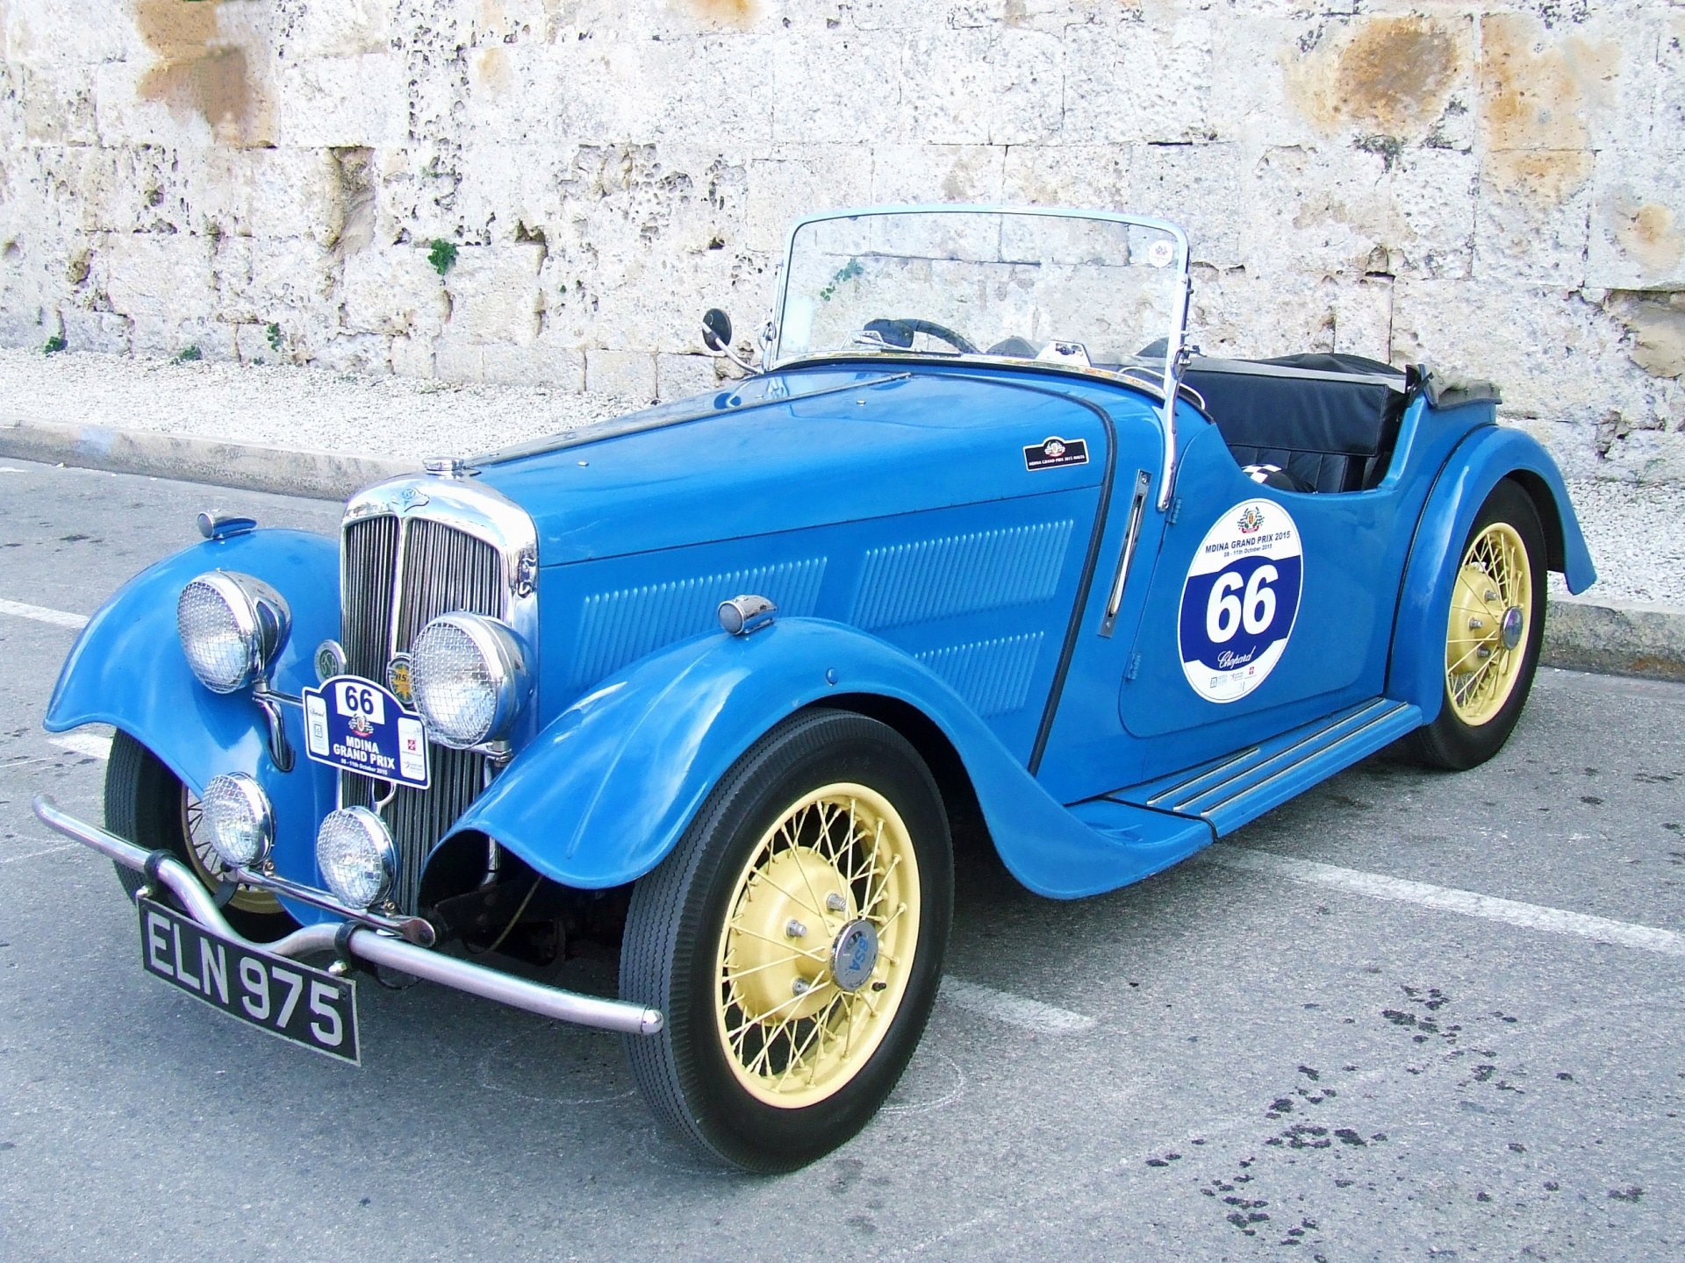
GBI on Syntactic Parsing
Application 2: Syntactic constituency parsing.
One of the fundamental problem studied in NLP for decades.
Provides structure to NLP tasks.
Sentiment analysis, Translations, Named Entity Recognitions, ….
NP
NP
blue car (en)
voiture bleue (fr)
Notes:
A bit of explanation on imitation learning

Slide 115

GBI on Syntactic Parsing
Application 2: Syntactic constituency parsing.
One of the fundamental problem studied in NLP for decades.
Provides structure to NLP tasks.
Sentiment analysis, Translations, Named Entity Recognitions, ….
e.g.) “This film does not care about cleverness, wit or any other kind of intelligent humor" (Socher et al EMLNP 2013)
Bag of Words
Notes:
A bit of explanation on imitation learning

Slide 116
GBI on
GBI in detail

Slide 117
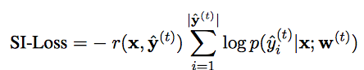
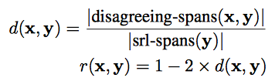
Learning with constraints
DETAIL
Proposed methods
Output inconsistency (OI-Loss)

Slide 118
Gradient-Based Inference (GBI)
Motivation
Modified Lagrangian Relaxation
Gradient-Based Inference
Likelihood
Constraint violation
Notes:
Throw in some neural network equations h_t = f(W*x_t)

Slide 119
Gradient-Based Inference (GBI)
Motivation
Modified Lagrangian Relaxation
Gradient-Based Inference
Regularizer
Notes:
A bit of explanation on imitation learning

Slide 120
Gradient-Based Inference (GBI)
Motivation
Optimization with constraints
Standard Lagrangian Relaxation
Notes:
Throw in some neural network equations h_t = f(W*x_t)

Slide 121
Gradient-Based Inference (GBI)
Motivation
Optimization with constraints
Standard Lagrangian Relaxation
Modified Lagrangian Relaxation
Likelihood
Constraint violation
Notes:
Constraints that are not localized.

Slide 122
Gradient-Based Inference (GBI)
Motivation
Standard Lagrangian Relaxation
Gradient-Based Inference
Notes:
change it to intuition
Proposed model

Slide 123
Gradient-Based Inference (GBI)
Motivation
Modified Lagrangian Relaxation
Gradient-Based Inference
Notes:
Throw in some neural network equations h_t = f(W*x_t)

Slide 124
Gradient-Based Inference (GBI)
Motivation
Modified Lagrangian Relaxation
Gradient-Based Inference
Likelihood
Constraint violation
Notes:
Throw in some neural network equations h_t = f(W*x_t)

Slide 125
Gradient-Based Inference (GBI)
Motivation
Modified Lagrangian Relaxation
Gradient-Based Inference
Regularizer
Notes:
A bit of explanation on imitation learning

Slide 126
Gradient-Based Inference (GBI)
Optimization with constraints
Gradient-Based Inference (in math)
Notes:
Throw in some neural network equations h_t = f(W*x_t)

Slide 127
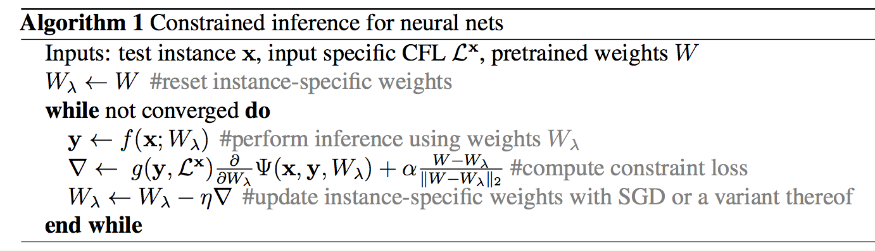
Gradient-Based Inference (GBI)
DETAIL
GBI (in Algorithm)
Initiate as model weight
Jay Yoon Lee et al, Gradient-based Inference for Networks with Output Constraint, AAAI 2019

Slide 128
Gradient-Based Inference (GBI)
DETAIL
GBI (in Algorithm)
Jay Yoon Lee et al, Gradient-based Inference for Networks with Output Constraint, AAAI 2019

Slide 129
Gradient-Based Inference (GBI)
DETAIL
GBI (in Algorithm)
Jay Yoon Lee et al, Gradient-based Inference for Networks with Output Constraint, AAAI 2019
Notes:
A bit of explanation on imitation learning

Slide 130
Gradient-Based Inference (GBI)
DETAIL
GBI (in Algorithm)
Reset for new instance
Jay Yoon Lee et al, Gradient-based Inference for Networks with Output Constraint, AAAI 2019
Notes:
A bit of explanation on imitation learning

Slide 131
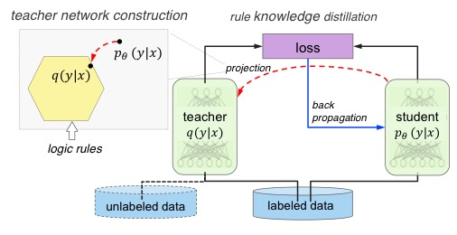
Posterior Regularization & Distillation
Ganchev et al., 2010, Hu et al., (ACL2016, EMNLP2016, NIPS2018), Hinton et al, 2016
Using posterior regularization,
The base distribution is only stable for problems that current output does not depend on previous output (no seq2seq). (Hu 2016)
Different way of injecting score. (Mine is direct score of rules whereas PR samples from base probability times exponentiated payoff function.
Also, sampling (Hu 2018) from q distrbution is required, not easy to do for complicated structures.
The NIPS2018 paper does importance sampling with MC sampling on normalization factor. (The author told me that he only samples 5 times)
The distribution changes constantly, and not sure how well 5 step MC step will approximate normalization factor.
sampling

